Slide 1
Determining Selection Behavior of Malicious Bots within Twitch Chat
Andrew Yarbrough
Tanner Bonds

Slide 2
Overview
Introduction
Twitch
Malicious Bots
Selection Behavior
Related Work
Twitter
Approach
Data Gathering
Methodology
Analysis & Twitter Comparison
Results

Slide 3
Introduction

Slide 4

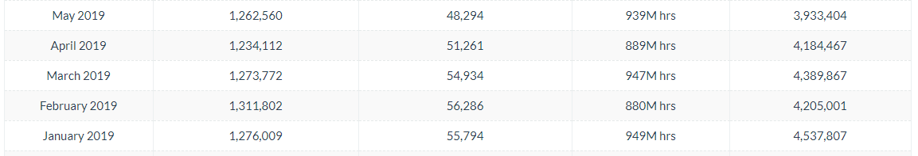
Twitch & Twitch Chat
Popular Internet Live Streaming Service
Users Can Comment Directly In Real-Time
Owned By Amazon
Average Daily ~1.2 Million Concurrent Viewers
Tends to Peak in March

Slide 5
Malicious Bots
Bots
A bot is any sort of user that runs an automated task, also known as a script, over the internet.
What is Spam?
Spamming is the act of sending unsolicited messages, often repeatedly, on the same website. These spam messages are typically used for advertising purposes
How It Works (In Twitch)?
Bots post links in high frequency that typically lead to some advertisement
What Is Phishing?
The fraudulent attempt to obtain sensitive info such as usernames, passwords, credit card details, etc. by disguising oneself as a trustworthy entity in an electronic communication
How It Works (In Twitch)?
Create a bot that says it claims to post something that helps you but is malicious
Notes:
Bots typically perform tasks that are simple and repetitive but can complete these tasks at speeds of a much higher rate than humans can, all while expending less resources.
Tanner

Slide 6
Selection Behavior
What Is Selection Behavior?
Determining how the next target of the bot will be chosen.
Notes:
Tanner

Slide 7
Twitter
John Seymour and Philip Tully with SNAP_R
Targets groups of users on Twitter and sends them appropriate phishing tweets based on machine learning techniques.
Uses general phishing tweets on Twitter to create learning model and then creates groups and categorizes users into these groups based on profile, job, types of things they tweet, etc.
Grant Stafford and Louis Lei Yu
Spammers make use of trending topics in Twitter to produce large quantities of spam tweets to acquire more users to click on their links.

Slide 8
Approach

Slide 9
Data Gathering
Week & A Half / March 18 - March 29
Spring Break Overlap
Twitch Chat Logger on Github
Notes:
The Chat Logger does not have any functions that write to the Twitch chat of any channel it enters. To ensure it does not do this, we will thoroughly review the source code and make any changes to ensure that the bots do not type in chat. Also, we will thoroughly test the chat logger in the weeks prior to data gathering to ensure that the Chat Logger does not post any errors in the Twitch chat or from any other source of errors.

Slide 10
Methodology
10 Instances Each. 20 Total.
10 Monitored the Top 10 Streamers w/ Most Viewers
10 Monitored the Top 10 Streamers w/ Most Viewers < 1,000.
Ran for Several Hours
Stored as .log Files.
Notes:
Tanner

Slide 11
Analysis
Privacy
Find Links In Messages, Remove All Others
Enter Links into Google’s Safe Browsing API
Patterns
Similar Bots with Similar Links across Multiple Channels
Similar Bots with Different Links across Multiple Channels
Different Bots with Similar Links across Multiple Channels
Notes:
Tanner

Slide 12
Twitch & Twitter
Comparison of Findings
URL Shorteners
Similar Phishing Attacks
Notes:
Tanner

Slide 13
Results

Slide 14
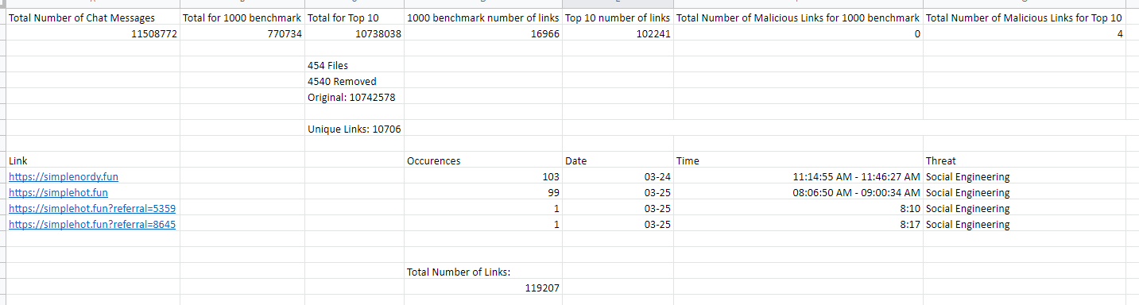
Our Excel Doc

Slide 15
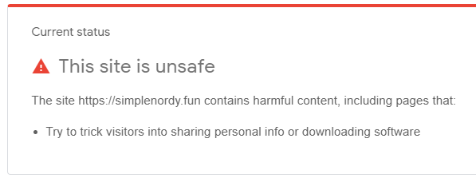
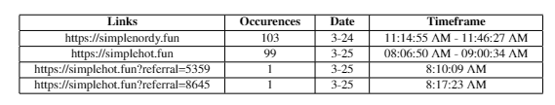
Malicious Links
Google’s API reported 4 links as malicious
All 4 links occurred in the same 2 Twitch streams
One occurred 103 times, another 99, then 1, and 1

Slide 16
Advertising Links
Sponsored Links
Promoted Links
Replay Clips
Notes:
Google’s Safe Browsing API did not return these links as malicious; instead, they were found to be safe to travel too. However, as we stated earlier, we are also looking for spam and phishing links. We investigated the remaining links to see if there were any trends in them and what type of links they were and found that each link was either a self-promotion link, a link promoting another streamer or clips that streamers allow viewers to capture of the stream for replays. Streamers make money from their streams by having a large amount of follows under their wings. So, in order to keep their numbers high, streamers will post promotion links that either lead viewers to join their messaging platform (Discord), or their social media accounts, or even sponsor links. Sponsor links are links provided by sponsors to streams to promote their product. An example of a sponsored link would be Rogue Energy Drink providing a link to a stream for them to post in their chat to promote the drink. In exchange, the sponsor pays the streamer a large sum of money (usually in the thousands) passed on their viewership. We also mentioned that some of the links are for short highlights videos, commonly called replay clips. Many streamers have a unique bot/program in place on their streams that allow viewers to type a particular command in chat that will record a certain amount of time in the stream and then replay it. The times vary depending on the streamer’s settings.

Slide 17
Streamer Security
Thankfully, our results and suspicions about Twitch were wrong.
Streamers take much better care about the security of their viewers than most individuals do about themselves.
Most streamers turn on a setting that makes it so that only they, and those they allow, can post links in chat.

Slide 18
Twitch & Twitter
Inconclusive, Comparison cannot be made.
This itself is a result!
Twitch appears to have little to no malicious presence, the same cannot be said for Twitter.
Notes:
Tanner

Slide 19
Comments and Questions?

